Slide 1
Avanade DevOps Practitioner
Using Azure DevOps Services
Security in DevOps

Slide 2



Expectations During Sessions
Share input and ask questions
Participate in the activities
Avoid distractions

Slide 3
Avanade DevOps Practitioner Sessions
Sessions
1 | Pre-work overview
2 | Using Azure DevOps Services. Security in DevOps
3 | Architecture and technical practices to create fast flow from development into operations
4 | Technical practices to create fast and continuous feedback from operations to development
5 | Technical practices to create opportunities for experimentation and continuous learning
6 | Azure security and compliance
Session Agenda
Azure DevOps for client projects, experimentation, Avanade Scrum Plus PT, Azure Boards, Delivery Plans.
Security in DevOps.

Slide 4
Session 2 (2.5 hr)
Using Azure DevOps Services
For Client Project
For Experimentation
Avanade Scrum Plus Process Template
Plan and track work items using Azure Boards
Manage delivery plans across teams
Security in DevOps
Security needs to be pervasive
Security is a shared responsibility
End to end practice (code, build, release, platform)
Securing Azure Platform
User accounts vs Managed Identities

Slide 5
Using Azure DevOps Services

Slide 6
Azure DevOps Services Primer
Azure DevOps Services is Microsoft’s cloud version of their Azure DevOps Server. Both provide:​
Source Control Management (SCM)​
Work Item Tracking (WIT)​
Project Management via the use of Process Templates (PT). PTs define the types of work item to be used (e.g. Task, Requirement, Test) and the workflow process around them (e.g. Draft, Approved, Done etc.)​
Azure DevOps Services provides a cost competitive solution for the SCM and WIT components of a project’s development architecture and much more. It is quick to setup (seconds) and is all managed via an online interface. It is fully integrated into the Visual Studio Integrated Development Environment (IDE)
Microsoft’s cloud-first model ensures that new features are added to AzDO Services first then added to Server Azure DevOps Feature Timeline | Microsoft Docs
It is secured using Azure Active Directory (AAD). AAD management is either implicit if you don’t have a linked Azure Subscription (hidden in the background) or explicit if you do (you can manage the AAD directly).​

Slide 7
Azure DevOps Services - Authentication
Microsoft account (MSA)
Using MSA (e.g. hotmail, live):
Create a new organization from www.visualstudio.com
Or create a new DevOps Starter resource from an existing Azure Subscription
Only Microsoft accounts can be used.
Avanade Azure Active Directory (Azure AD)
NOT linked with Azure Subscription
Using Avanade account:
Create a new organization from www.visualstudio.com
Linked with Avanade Azure AD
Not linked with Azure subscription for billing
Only Avanade Azure AD accounts can be used.
Avanade Azure Active Directory (Azure AD)
LINKED with Azure Subscription through ACP https://in.accenture.com/accenturecloudplatform/
Using Avanade account:
Linked with Azure Subscription for billing
Or create a new DevOps Starter resource from an existing Azure Subscription
Only Avanade Azure AD accounts can be used.
Project specific subscription and project Azure AD
Connect an organization linked to an Azure Subscription to project Azure AD and then adding Avanade.com and client.com users to that Azure AD
Both Avanade.com, client.com and local Azure AD users can be used.
Can also support MSA but these should NOT be used
Client Only Azure AD
Connect an organization linked to an Azure Subscription to Client Azure AD
Only client.com accounts like joe.fisher@client.com can be used.
Avanade employees will need to be added to client’s AD as members or guests.
PERMITTED FOR EXPERIMENTAION
REQUIRES ADDITIONAL CONTROLS
NOT PERMITTED FOR CLIENT OR AVANADE INTERNAL WORK
PERMITTED FOR CLIENT OR AVANADE INTERNAL WORK

Slide 8
Azure DevOps Access Levels
Stakeholder
Provides partial access, can be assigned to unlimited users for free. Assign to users with no license or subscriptions who need access to a limited set of features
Basic
Provides access to most features. Assign to users with a Visual Studio Professional subscription, an Azure DevOps Server CAL, and to users for whom you're paying for Basic access in an organization.
Basic + Test Plans
Provides access to all features included in Basic, as well as Azure Test Plans. Assign to users with a Visual Studio Test Professional or MSDN Platforms subscription, and to users for whom you're paying for Basic + Test Plans access in an organization
Visual Studio subscription
Assign to users who already have a Visual Studio subscription. The system automatically recognizes the user's subscription—Visual Studio Enterprise, Visual Studio Professional, Visual Studio Test Professional, or MSDN Platform—and enables any other features that are included in their subscription level. If you assign Basic or Stakeholder, they also receive their Visual Studio subscription benefits upon sign-in.
At Avanade, we leverage Visual Studio subscription even for client engagements
Notes:
References:
https://docs.microsoft.com/en-us/azure/devops/organizations/security/access-levels?view=azure-devops
https://docs.microsoft.com/en-us/visualstudio/subscriptions/vs-alternate-identity

Slide 9
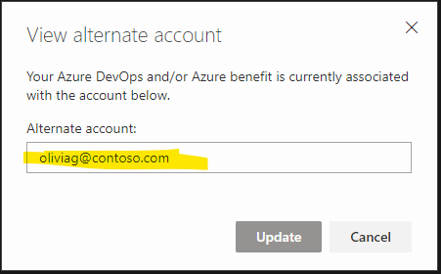
Add an alternate account to your subscription
Identities for Visual Studio subscribers | Microsoft Docs
Sign in to the Visual Studio subscriber portal with your Microsoft account
Seelct Subscriptions tab
Choose Add alternate account
Add Avanade email id
Use Avanade account to sign in to Azure DevOps
Notes:
References:
https://docs.microsoft.com/en-us/visualstudio/subscriptions/vs-alternate-identity

Slide 10
Avanade Scrum Plus Process Template v1.0
Avanade Scrum Plus Azure DevOps Process template enriches the standard Scrum template with:
Work Item Templates:
Minor updates to Epic, Feature, PBI, Task, Bug and Impediment Work Items to support the ability to generate reports/KPI.
Additional Work Items delivery management:
Impediments (i.e., issues)
Risks, Decisions/Assumptions
Change Management, Questions
Milestones, Dependencies
Shared Queries for:
Change Management
Dashboards
Planning and Tracking work
PowerBI Reports:
Current Sprint Burn Up/Burn Down
Current Sprint PBI Status Report
Current Sprint Team Member Status Report
Sprint Defect Report
Feature Target Release Report
Predefined Dashboards for monitoring:
Team Member Progress Dashboard
Current Sprint Progress Dashboard
Sprint Performance Dashboard
Stakeholder Dashboard
Program Overview Dashboard
Note that the list of enhancements above is just a starting point. It will enable Azure DevOps to support your common implementation, but it is meant to evolve and be enriched by your own project experience and lessons learned.
The PT can be made available in Azure DevOps organization by using Modern Engineering Self-Service Portal (messp.Avanade.com).

Slide 11
Avanade Scrum Plus Process Template v1.0
Let us explore ADF guidance: The user guide Scrum+ Process Template - User Guide - Avanade Delivery Framework (ADF)
Azure DevOps is the recommended toolset for managing and tracking all projects using Agile approach
The ME Mobilization Service is a cost-effective end to end solution to Mobilize an Azure for DevOps Project with Avanade Scrum+ Process Template through the ME Team.
Step 1: Prerequisites/ Things to Consider
Step 2: Self Service Portal (Project Provisioning with Scrum+ Process Template)
Step3: Other Configuration
Notes:
References: https://adf.avanade.com/pages/viewpage.action?pageId=83951703

Slide 12
Azure Boards
Let us explore Microsoft documentation: Key areas of Azure Boards documentation | Microsoft Docs
What is Azure Boards
Implement Scrum, track work in sprints - Azure Boards | Microsoft Docs
Review team delivery plans - Azure Boards | Microsoft Docs
Portfolio management - Azure Boards | Microsoft Docs
Implement Scaled Agile Framework®
Display rollup columns that show progress, counts, or totals - Azure Boards | Microsoft Docs

Slide 13
Security in DevOps

Slide 14
Security as an end-to-end practice
CI
Secrets Management
CD
Environment testing
RBAC
Dependency Management
Security scanning
Run
Compliance Initiatives
Code
Secure code practices
Collaborative development

Slide 15
Security is a shared responsibility
As team, we all are accountable for security of solution we develop
Each line of code and each step of the development lifecycle contributes to the overall security of a solution
Code securely by design. For example, implement security in code, don’t assume anyone calling API will have access to perform that operation or can access the data
Don’t store secrets in code repository. Once in, they are indexed and available in history. Use Key Vault
Choose dependencies carefully. Make sure they are safe
Automate infrastructure creation and implement security configuration as part of it
Know our security Policy 56 and Application Scanning Service - Home (sharepoint.com)
Leverage tools such as SonarQube, WhiteSource, GitHub Advanced security to scan for vulnerabilities, code smells

Slide 16
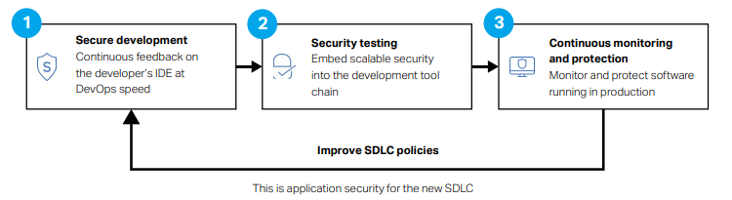
Policy 56: Static Code Scan Requirement

Slide 17


Avanade’s Tool for Scanning Applications
Fortify on Demand
Application security as a service with security testing, vulnerability management and support

Slide 18
Fortify Scans and Services
​Scan Types:​
Static Application Security Testing for Code (SAST)​
Dynamic Application Security Testing for Websites (DAST)​
Mobile Application Security Testing for Mobile Applications (MAST)​
Advanced Services :​
Security Assistant (SA) - It provides a real time, as you type code, security analysis and results. It provides structural and configuration analyzers which are purpose built for speed and efficiency to power our most instantaneous security feedback tool​
Source Code analyzer (SCA) - It is a static application security testing (SAST) offering used by development groups and security professionals to analyze the source code for security vulnerabilities. It reviews code and helps developers identify, prioritize, and resolve issues with less effort and in less time.​
IDE plugins for Automated scans

Slide 19
Fortify Integrations
Fortify Security Assistant, IDE Plugins, Integrations Bring Security Closer to the Developer
Fortify Security Assistant empowers developers to take responsibility for their own code by finding and fixing application security defects during the coding process—eliminating potential security vulnerabilities before the code is even compiled.
This solution sits on the developer’s IDE and allows them to run get immediate security feedback continuously as code is developed.
It highlights vulnerable code, like spellchecker and offers suggestions for correcting it. It also features intuitive integration with integrated development environments (IDEs), making security awareness and vulnerability remediation fluid and natural.
Fortify IDE plugins enable developers to initiate scans, see identified issues with their code and collaborate with other teams for remediation.
Free with a Static Subscription.

Slide 20
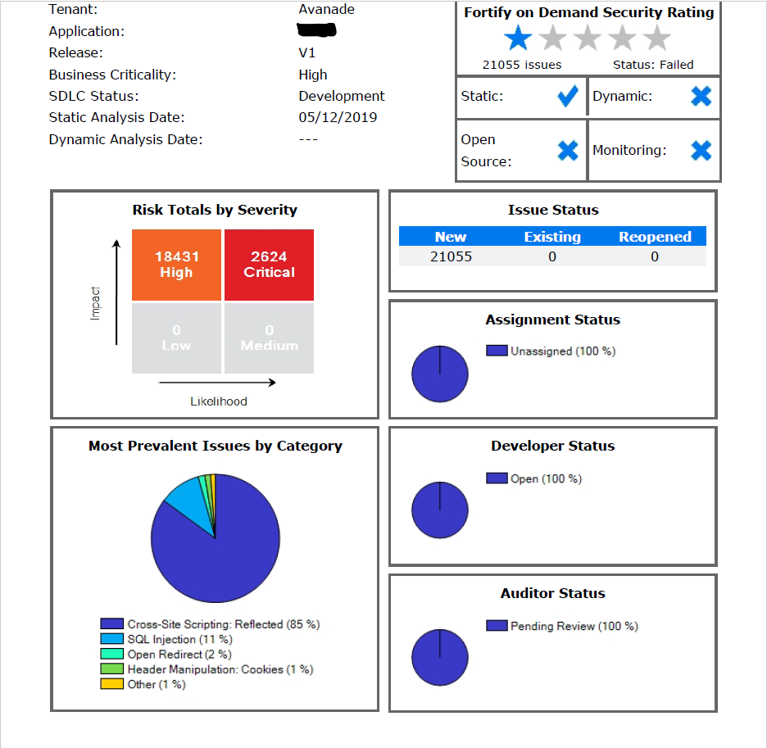
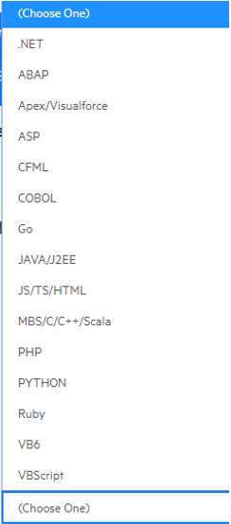
Static Code Scan Results
Languages we can scan:

Slide 21
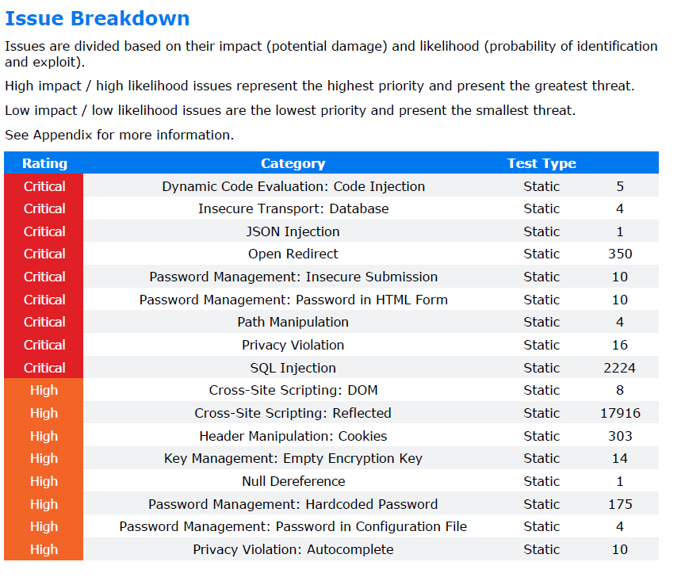
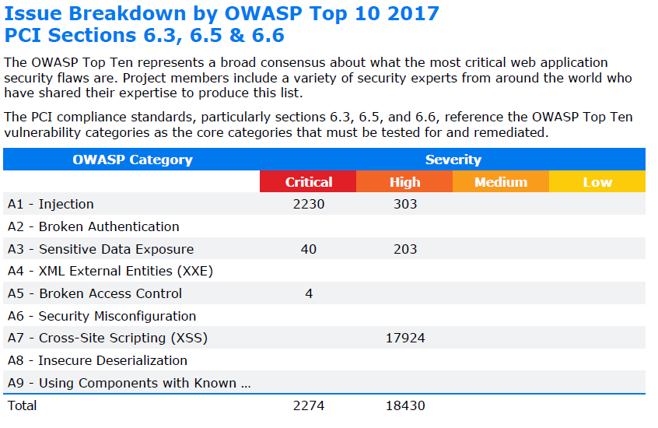


Summary Report Issue Breakdowns

Slide 22
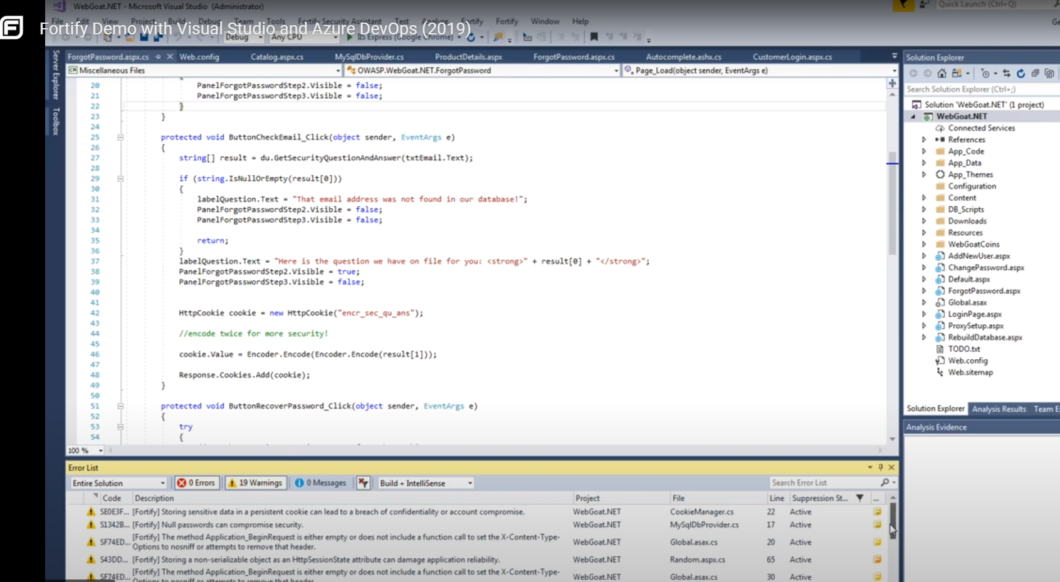
Fortify IDE Plugin

Slide 23
Current Pricing Model
Single Static Scan: 1 credit ($775)
Code is uploaded to Fortify
Rescan within 30 days: Free
Dynamic Scan: 2 credits ($1550)
URL endpoint is provided to Fortify
Rescan within 30 days: Free
Static Subscription: 4 credits ($3100)
Unlimited Scanning for 1 year
Dynamic Subscription: 6 credits ($4650)
Unlimited Scanning for 1 year
Security Assistant included.

Slide 24
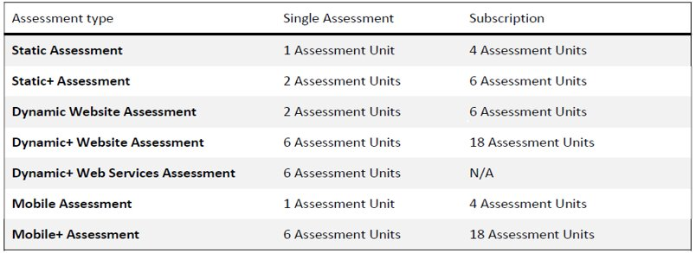
Resources
Find the below assets
Application Scanning

Slide 25
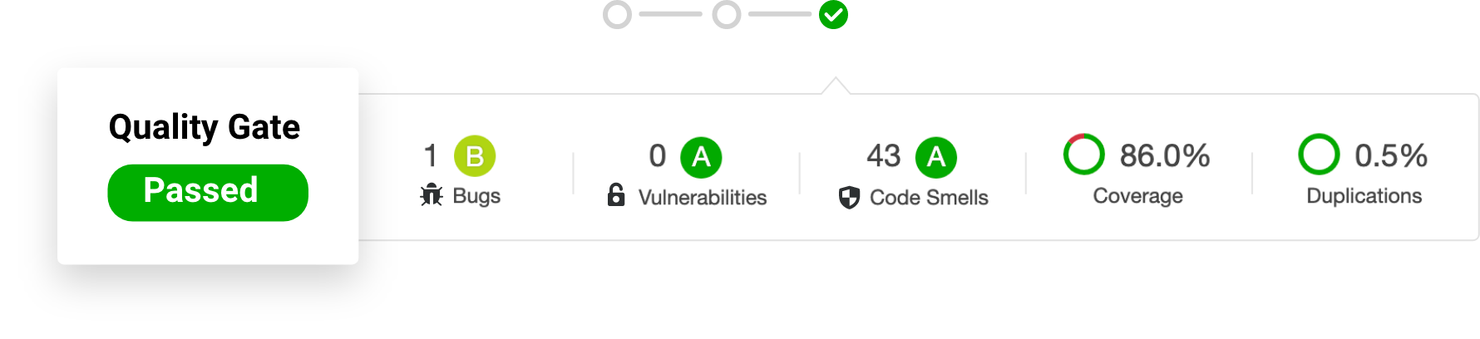
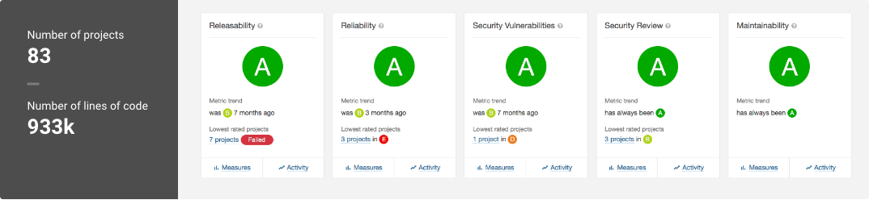
SonarQube
https://docs.microsoft.com/en-us/learn/modules/scan-for-vulnerabilities

Slide 26
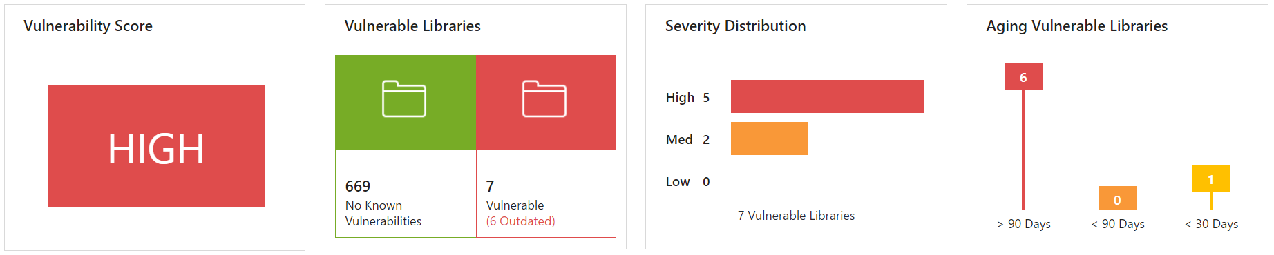
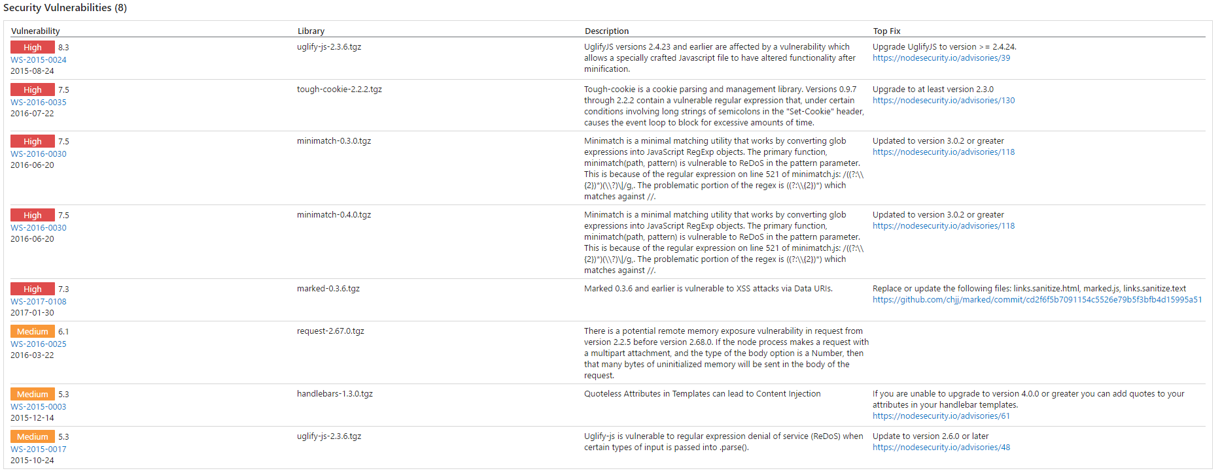
WhiteSource
https://docs.microsoft.com/en-us/learn/modules/scan-open-source

Slide 27
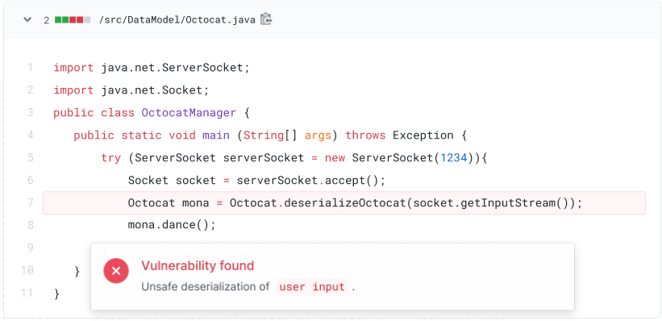
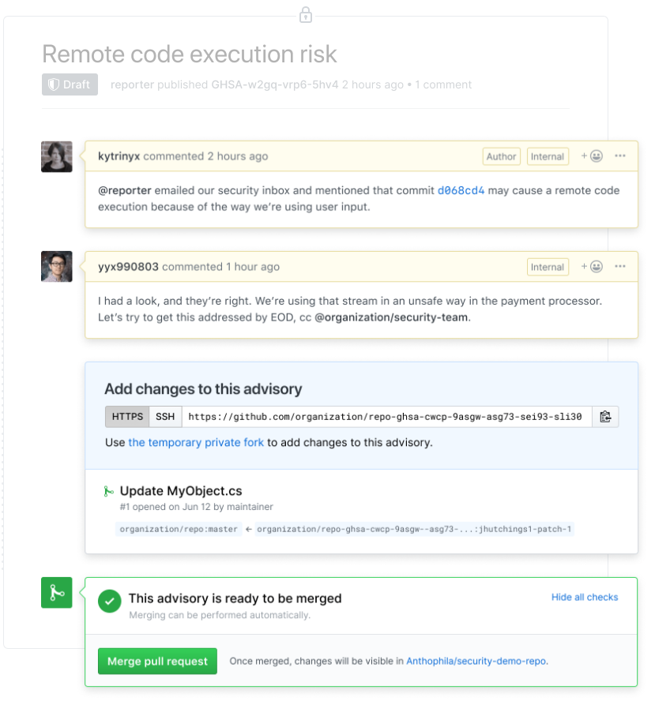
GitHub Advanced Security
Integrating Advanced Security in your Actions workflow will automate monitoring and alerting of code security issues
https://docs.microsoft.com/en-us/learn/modules/maintain-secure-repository-github

Slide 28
Securing Azure Platform
Don’t secure things afterwards, go for the secure approach as you go
Role Based Access Control (users, groups)
Often misunderstood, it’s the first barrier against unwanted access. The principle of least responsibility makes applications safer
Secure credentials
Service Principals, App Registrations, Managed Identities - Scoped and secure ways of allowing access
Notes:
https://docs.microsoft.com/en-us/learn/modules/intro-to-azure-ad
https://docs.microsoft.com/en-us/learn/modules/create-users-and-groups-in-azure-active-directory

Slide 29


Authentication with service principals in Azure AD
User account
A user has got a password
Credentials can be lost or stolen
Managed Identities
A Managed Identity is a secure way of allowing Azure Resources to interact with each other
Authentication happens via tokens in an automated fashion
A developer doesn’t need to even know the credentials – everything is handled by Azure in the form of RBAC assignments via AAD
Notes:
https://docs.microsoft.com/en-us/learn/modules/authenticate-apps-with-managed-identities

Slide 30
Key security risks with storing credentials in code or in configuration files
Passwords that are stored in plain text are accessible to anyone
Compromised user credentials threaten the network security of Avanade / Accenture / Clients enterprise domain
Compromised user credentials allow access to sensitive data like sales and marketing information
Adds unnecessary technical debt, requiring us to update / redeploy the application when credentials expire
Notes:
References: https://docs.microsoft.com/en-us/learn/modules/authenticate-apps-with-managed-identities/2-service-principals

Slide 31
Azure service principals improves application security
Say you are building an API.
Think of an Azure service principal as a proxy account, or identity, that represents your API to it’s consumer apps. This account is managed by Azure Active Directory (Azure AD).
Use Microsoft identity platform to provide a unified way to authenticate consumer apps. When consumer app successfully authenticates with Azure AD, it receives a unique token and will use it each time it makes a call to the API (or access a service)
One way to provision your API app for Microsoft identity platform is to use Azure portal to register the app
Sign into Azure portal → select Azure Active Directory → App registrations → New registration
When you finish the steps, the application is registered with Azure AD. It's also associated with a service principal
Other several ways are using PowerShell, Through CLI commands, using API calls (which is what MESSP does)
For your registered app, generate certificate / client secret that consumer app will use as credentials to authenticate requests (API calls)
Notes:
https://docs.microsoft.com/en-us/learn/modules/authenticate-apps-with-managed-identities/2-service-principals

Slide 32
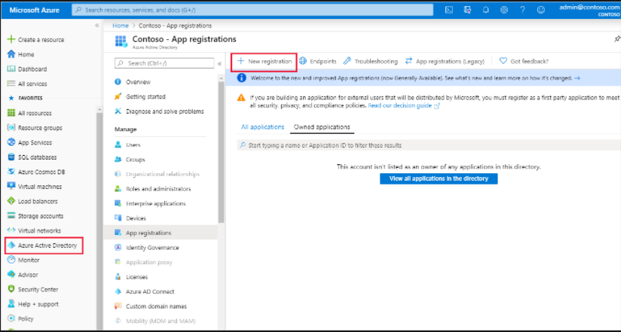
Azure service principals improves application security
One way to provision your API app for Microsoft identity platform is to use Azure portal to register the app
Sign into Azure portal → select Azure Active Directory → App registrations → New registration
When you finish the steps, the application is registered with Azure AD. It's also associated with a service principal
Other several ways are using PowerShell, Through CLI commands, using API calls (which is what MESSP does)
Notes:
https://docs.microsoft.com/en-us/learn/modules/authenticate-apps-with-managed-identities/2-service-principals

Slide 33
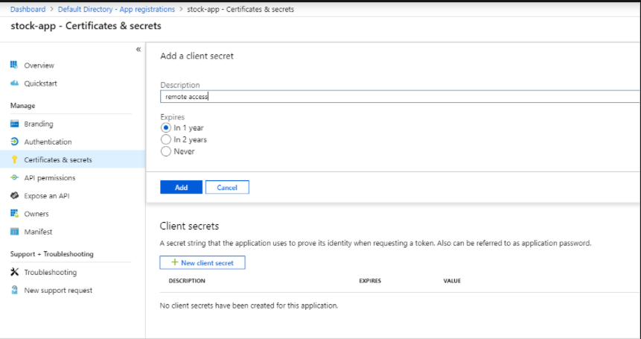
Azure service principals improves application security
For your registered app, generate certificate / client secret that consumer app will use as credentials to authenticate requests (API calls)
Consumer app will also need:
Directory (tenant) ID
Application (client) ID
Notes:
https://docs.microsoft.com/en-us/learn/modules/authenticate-apps-with-managed-identities/2-service-principals

Slide 34
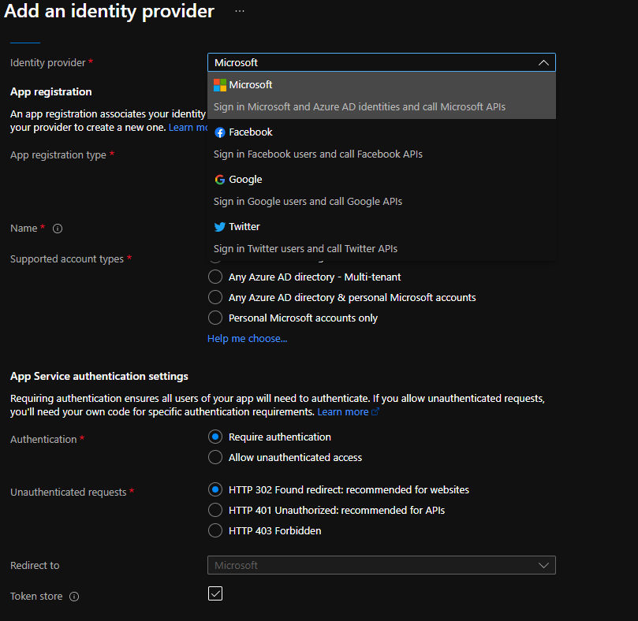
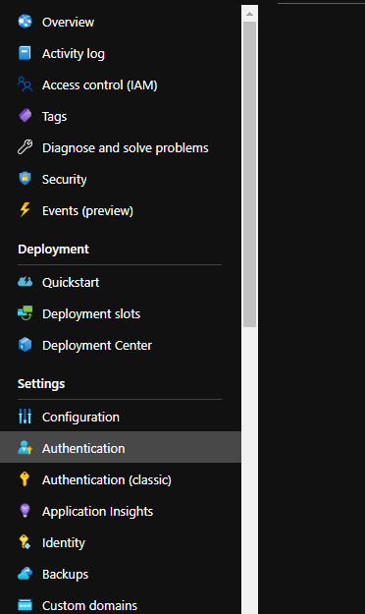
Configure Azure AD Authentication for API App
Access Authentication or Authentication (classis)
Disable Anonymous Authentication
Configure Azure AD authentication

Slide 35
Manage secrets in Azure Key Vault
In the tenant hosting consumer app
Create key vault
Store client secret (or certificate) in key vault
Configure access policy for consuming app
Set configuration for consuming app to read client secret from key vault
Write code in consuming app to read client secret from configuration (no additional code because of key vault)

Slide 36
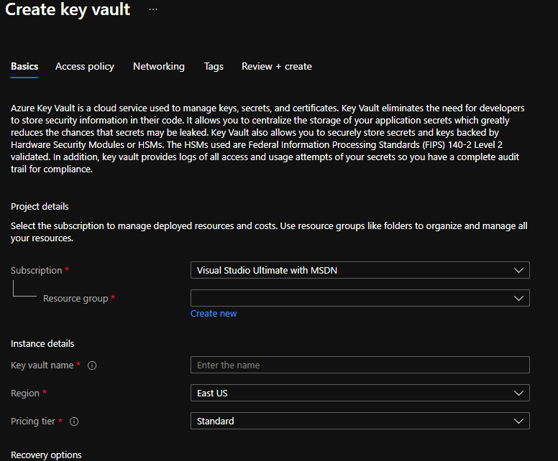
Manage secrets in Azure Key Vault
Create key vault

Slide 37
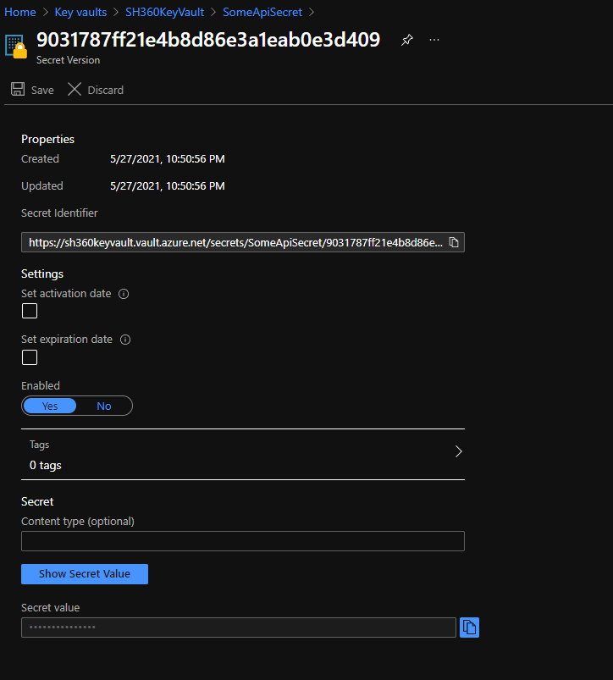
Manage secrets in Azure Key Vault
Store client secret (or certificate) in key vault
Make a note of the Secret Identifier Uri (you can access this later-on as well)

Slide 38
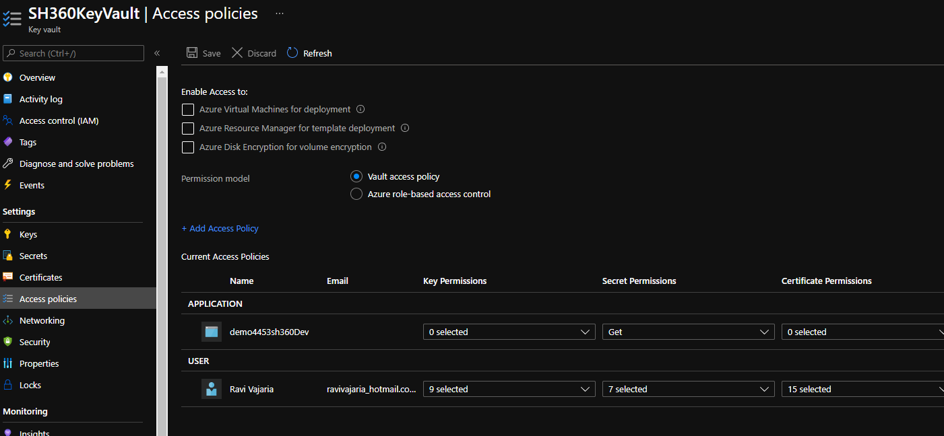
Manage secrets in Azure Key Vault
Configure access policy

Slide 39
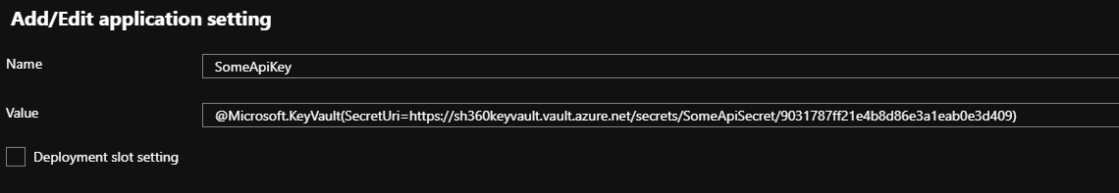
Manage secrets in Azure Key Vault
Set configuration for consuming app to read client secret from key vault

Slide 40
















Quality and Security: a sample lifecycle
SSC
Azure Pipelines
Vulnerability
Tracking
Work &Bug
Tracking
Orchestration / Break Build
Feedback
Azure Repos
Azure Pipelines
Design
Initiate
Build
Build &
Unit Test
Basic
Analysis
Deploy to
Dev Test
Dev
Test
Deploy to
QA
QA
Testing
Establish
Valid Build
Deploy
Operate
Monitor & Detect
Threat
Modelling
Container
Security
Partial
SAST
Smoke
Test
DAST and
Compliance Scan
Configuration
Scan
Web App
Pen Test
SIEM & RASP
Risk Analysis and Architecture
Composition
Analysis
Full
SAST
Fuzz
Test
Azure Artifacts
Legend
Quality
Security

